Slide 1

Using ASAP for Single-Cell analysis
2023 SIB Course (Online)
Vincent Gardeux
Deplancke’s Laboratory of Systems Biology and Genetics
Ecole Polytechnique Fédérale de Lausanne (EPFL), Switzerland

Slide 2


Single-cell RNA-seq
Each black circle is a cell, each colored dot is a transcript, colors encode transcript of the same gene
Macaulay IC, Voet T (2014) PLoS Genet

Slide 3

Single-cell ‘omics
2009 – Single-cell RNA-seq
2009 – Mass cytometry (CyTOF)
2014 – Single-cell Western Blot³
(New) 10x spatial proteomics
SC
transcriptomics
2015 – Single-cell DNA & RNA-seq: scG&T-seq¹
SC proteomics
Single-cell
SC genetics
Vistain & Tay, Trends in Biochemical. Sci.
2011 – Single-cell DNA-seq
SC
metabolomics
SC
epigenomics
2016 – Single-cell RNA-seq & Methylome: scM&T-seq²
(New) 10x ATAC & RNA-seq
2013 – scRRBS (methylome)
2015 – Single-cell ATAC-seq
¹Macaulay et al. Nature methods, 2015
²Angermueller et al. Nature methods, 2016
³Hugues et al. Nature methods, 2014

Slide 4
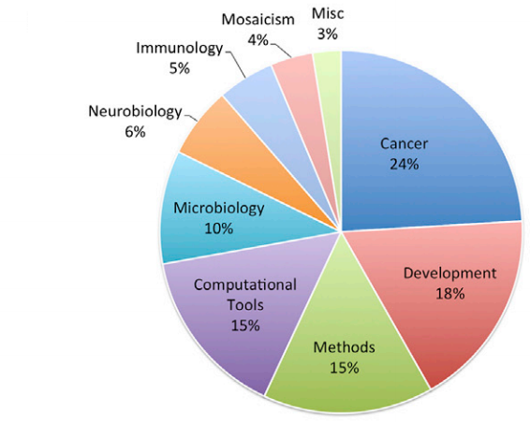
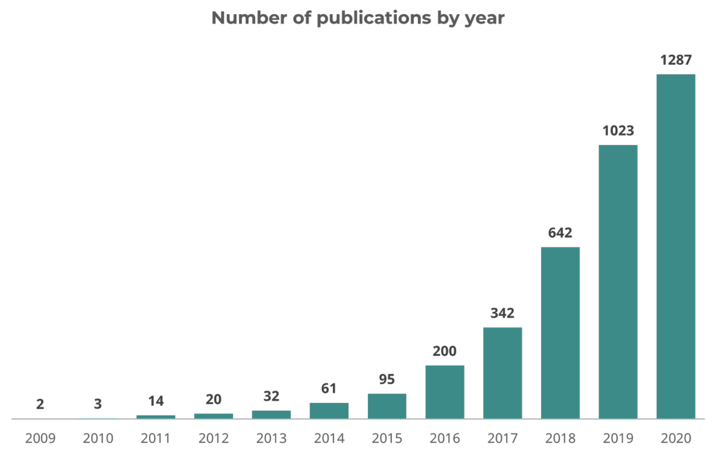
Single-cell genomics applications
Wang, Y., & Navin, N. E. (2015). Advances and applications of single-cell sequencing technologies. Molecular cell
Angerer & Theis (2017). Single cells make big data: New challenges and opportunities in transcriptomics. Current opinion in Systems biology

Slide 5
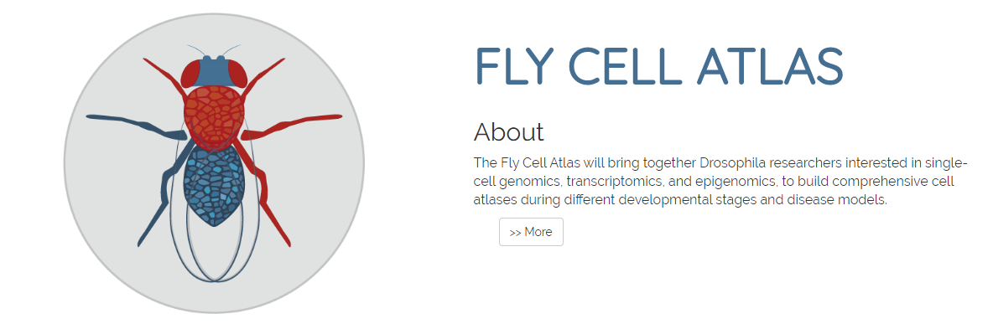

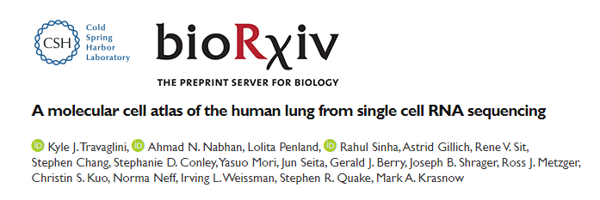

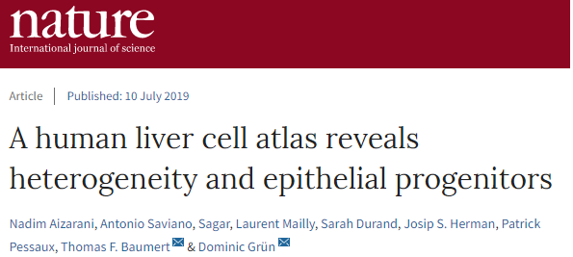
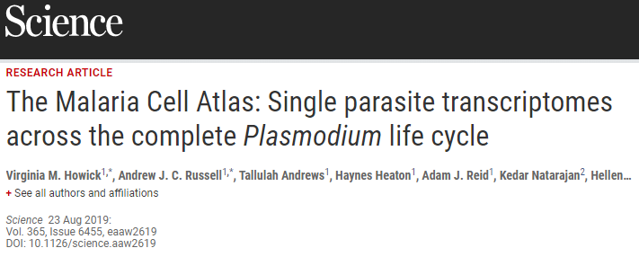
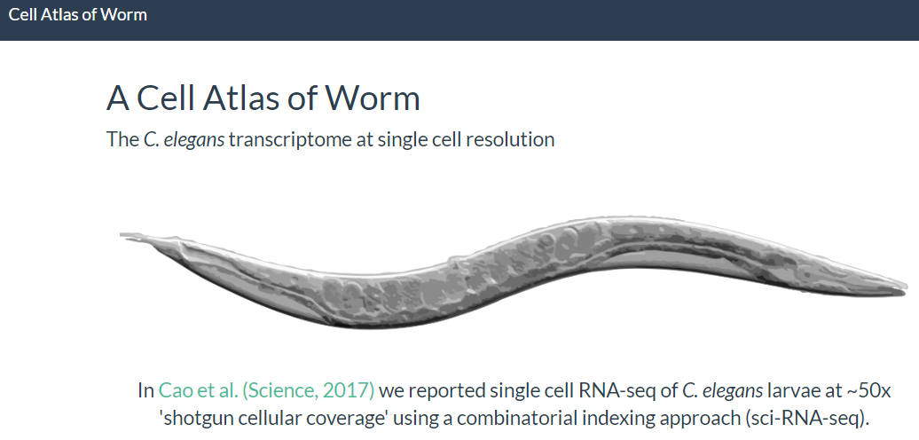
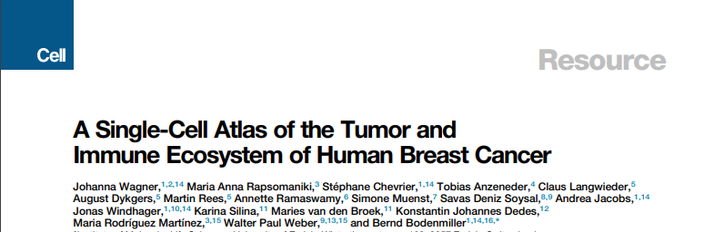
scRNA-seq applications – Creating XXX cell atlases

Slide 6

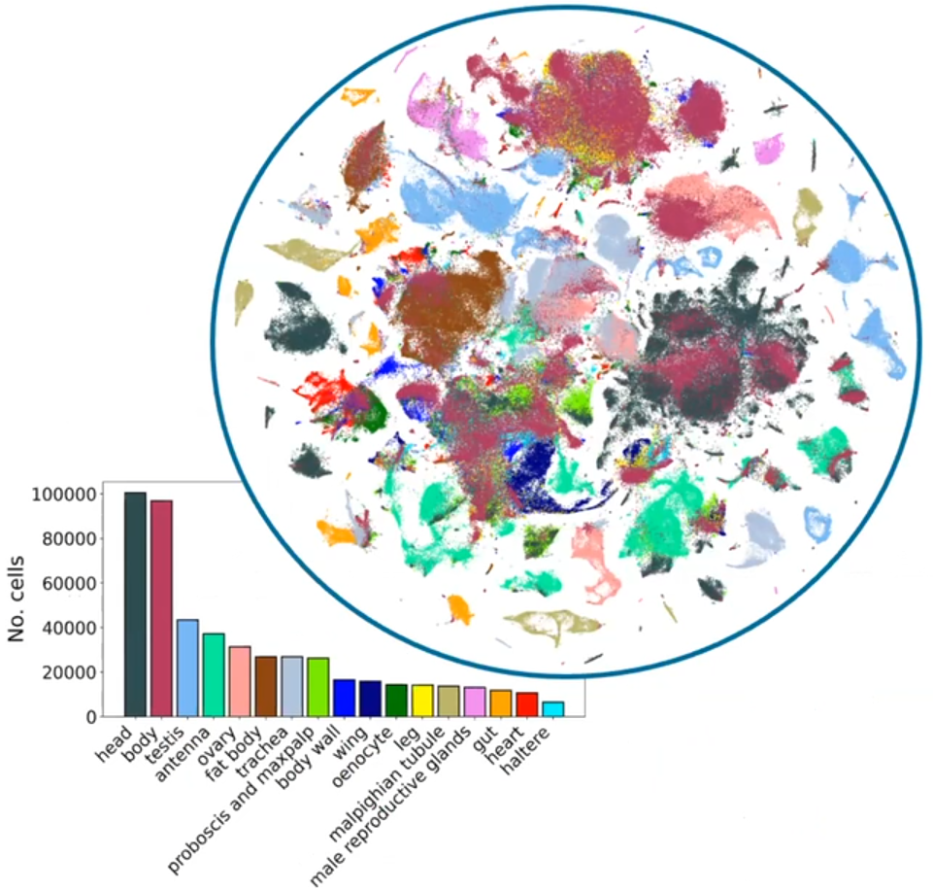


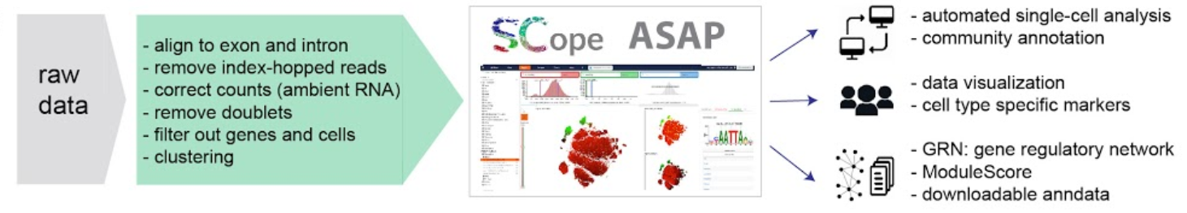

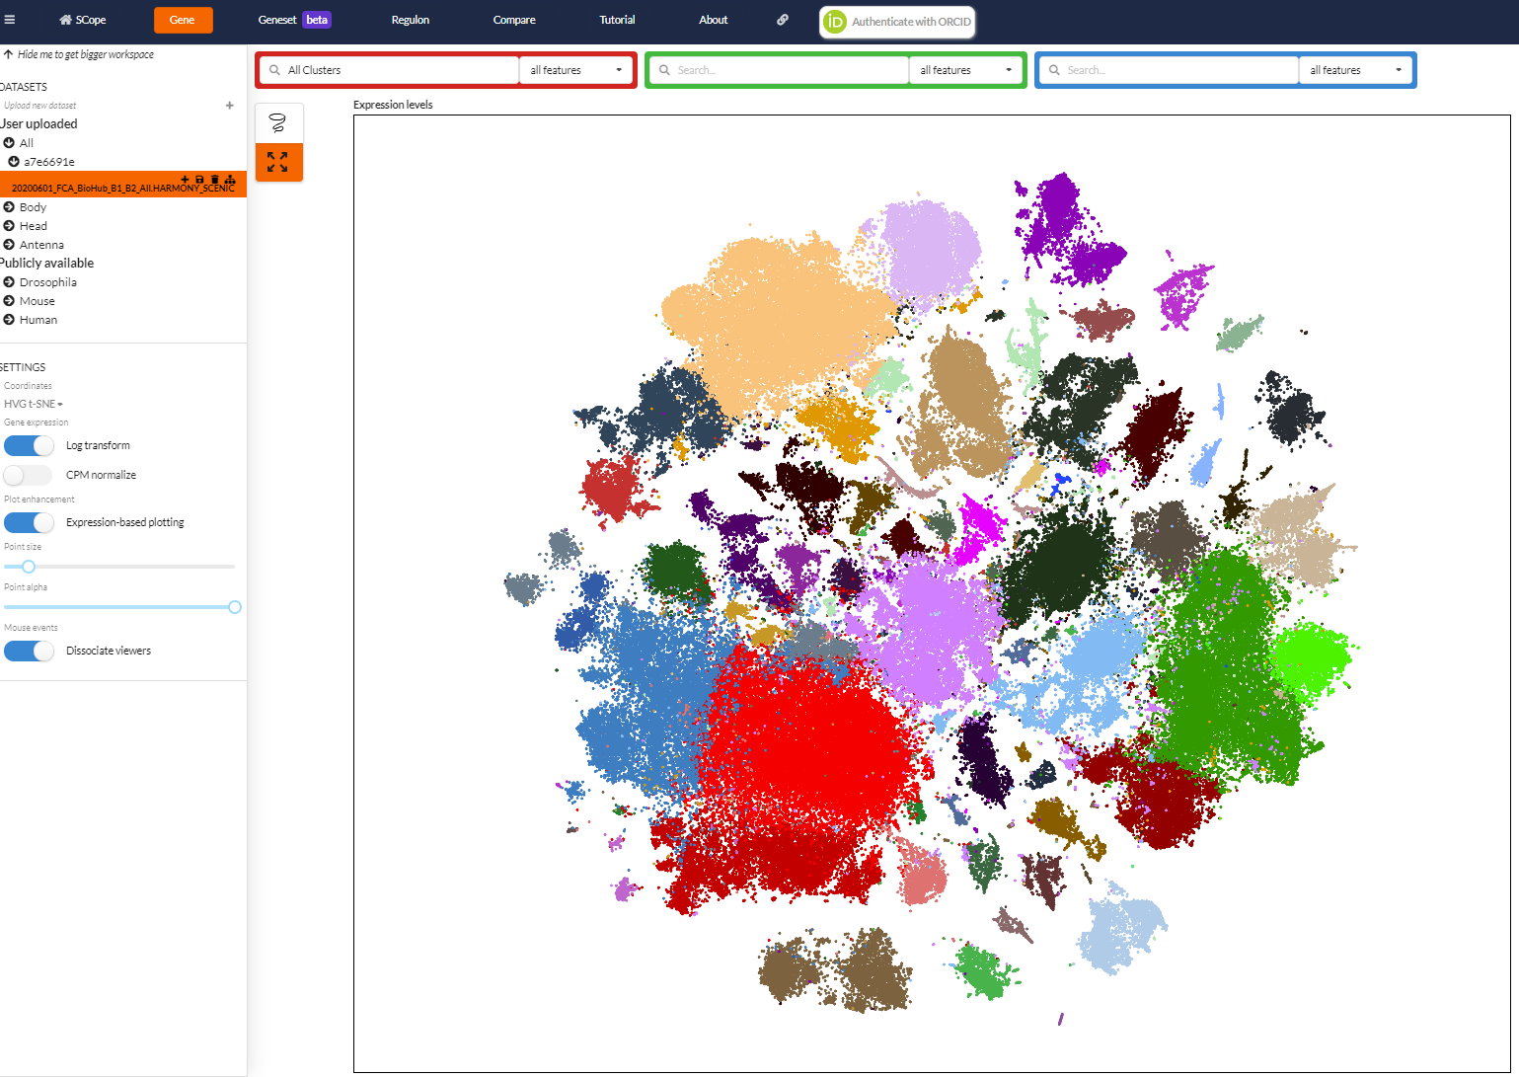
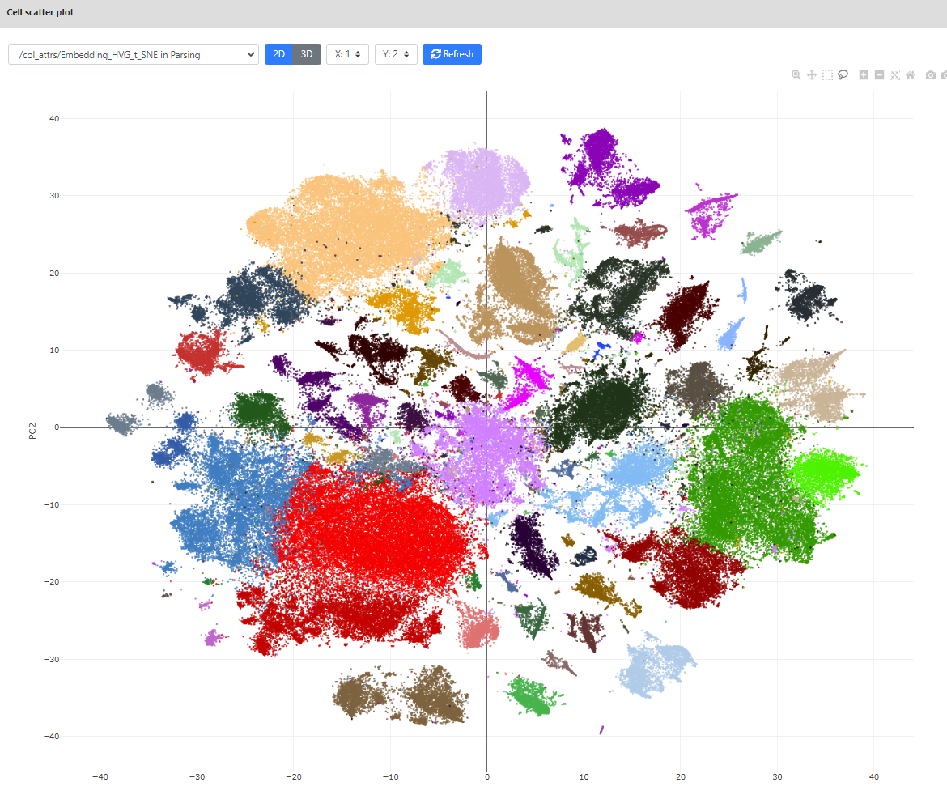

One of the latest atlases: the Fly Cell Atlas
https://flycellatlas.org/
A single-cell RNA-seq atlas of the drosophila melanogaster of 15 tissues, recapitulated in body and head
Data made available through two interactive portals: SCope and ASAP
63 10x runs
38 billion reads
570k cells using 10x
10k cells using SMART-Seq2
And also in
Data exchange
(.loom files, sub-clusters)
https://scope.aertslab.org/
https://asap.epfl.ch/
Li et al., Science, 2022

Slide 7
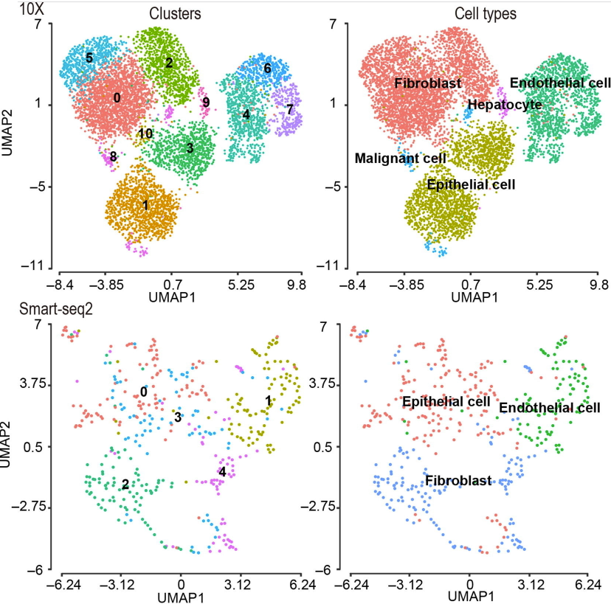
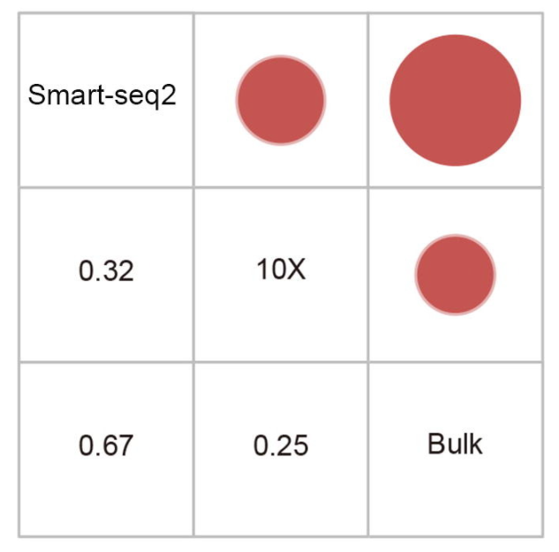
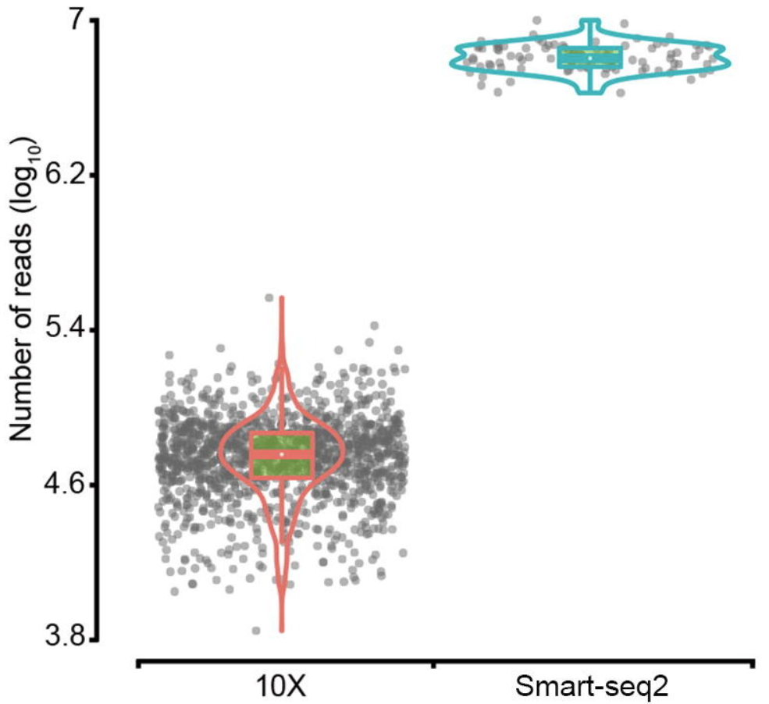
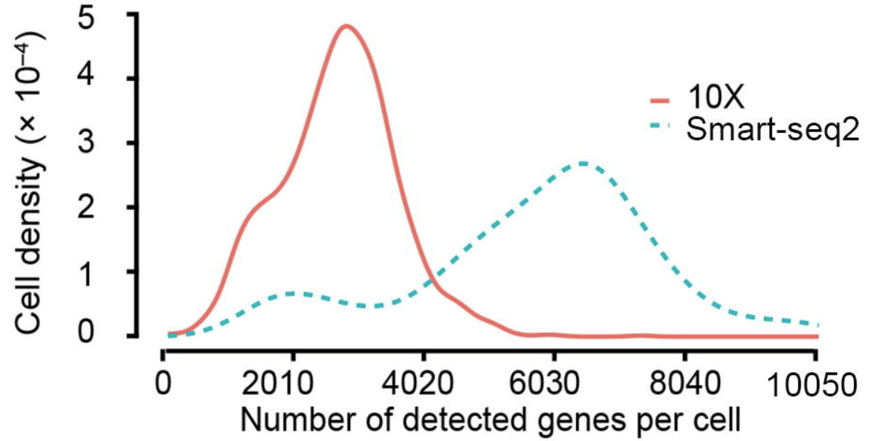
Which protocol to use? Two main protocols currently in use: Smart-seq vs 10x
X. Wang, Y. He, et al, Genomics, Proteomics & Bioinformatics, 2021

Slide 8


Community needs: « I want to do single-cell ! »
I finally got good
single-cell data!!

Slide 9

Community needs: « But how do I analyze single-cell data? »
??
Which tools to use?
R? Python?
Typical bottleneck

Slide 10
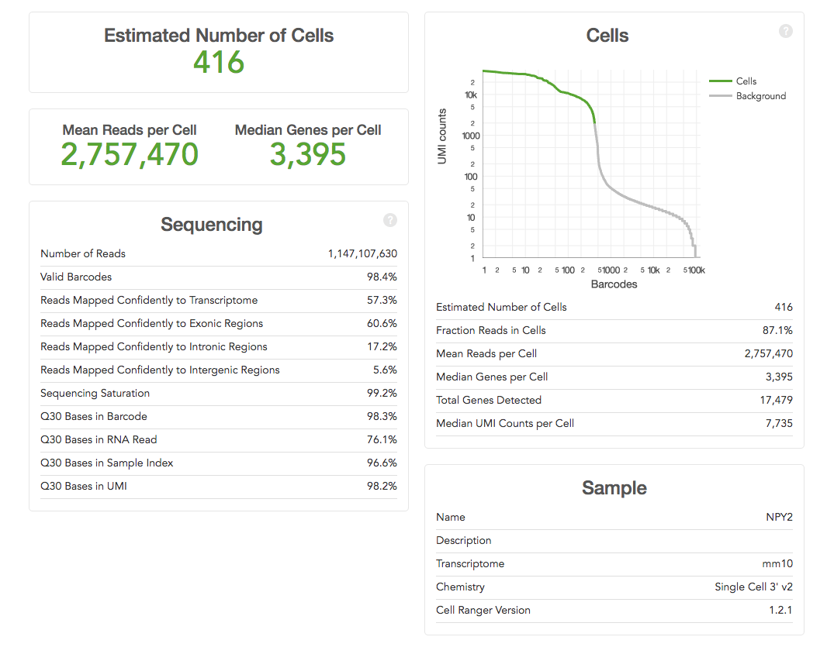


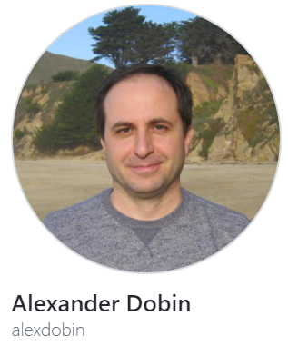




scRNA-seq analysis pipeline
Mapping to reference genome
PREPROCESSING
Demultiplexing & QC
UNIX / bash
Read/transcript matrix
(raw counts/UMI or normalized data)
DOWNSTREAM ANALYSIS
Quality control & filtering (II)
Normalization, noise removal
Study-specific downstream analyses
to generate new biological insight
R / Python
Cell type identification
Cell type characterization
Gene network analysis
Kinetics of transcription

Slide 11
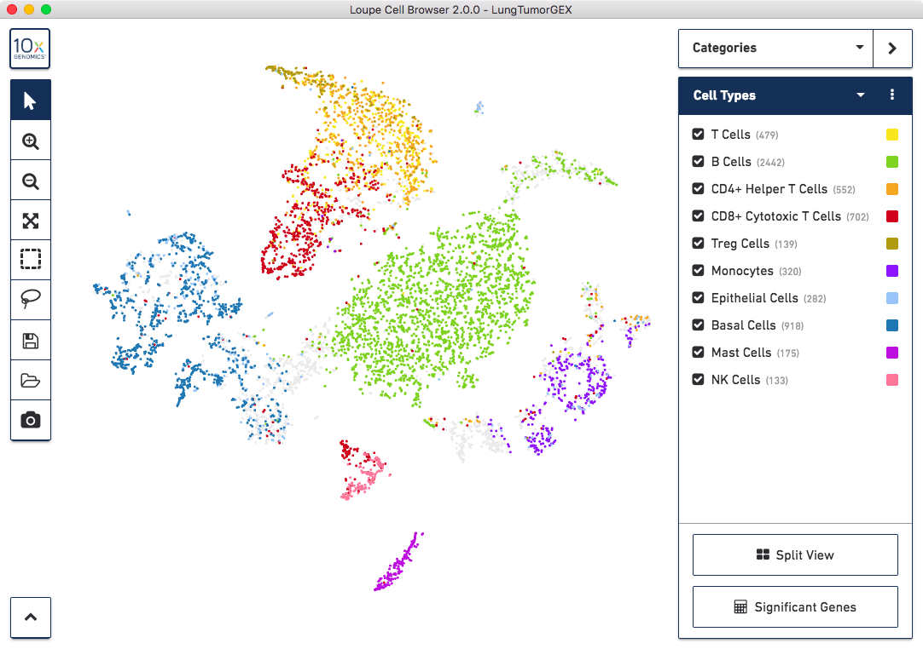
scRNA-seq analysis pipeline
"Black box" fixed pipeline?
e.g. 10x cell Ranger pipeline
+ Loupe Visualization
May be ok for preprocessing.
Usually insufficient for downstream analysis.

Slide 12
scRNA-seq pipeline may not be applicable to all datasets
Solutions
Standardized but parametrizable pipelines (e.g. Seurat, scanpy)
Requires R/Python coding skills. Takes time to implement thoroughly.
User-friendly automated analysis portals (e.g. ASAP, FastGenomics, …)
=> No coding required. Very fast to obtain results. Interactive. Modular. Reproducible.

Slide 13

Single-cell analysis pipelines
Two main pipelines for analyzing single-cell data:
Seurat ( in R ) from Satija lab (2015). Now in v5
SCANPY (in Python) from Theis lab (2018). Now in v1.8

Slide 14
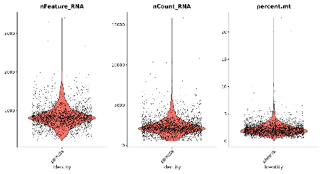
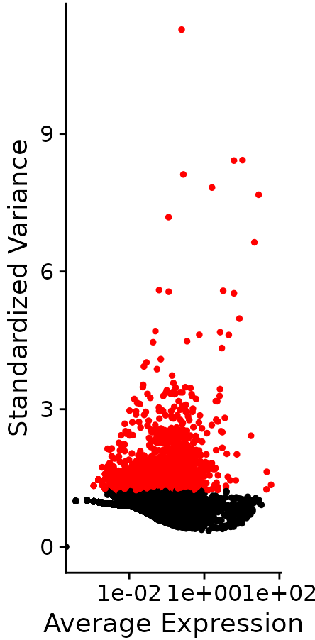
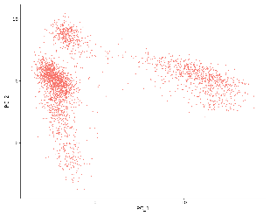
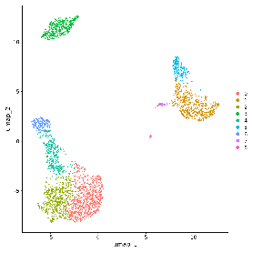
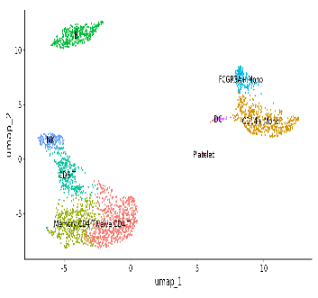
Downstream analysis
QC / Cell filtering
Normalization
Variable features (HVG)
Scaling / Covariate removal
PCA
UMAP
t-SNE
Clustering
Cell-type annotation
DE / Marker genes

Slide 15


Thanks
SIB 2023 course – Using ASAP for Single-Cell Analysis
Vincent Gardeux

